Slide 1
Current homepage (https://legal-monitr.com/)

Slide 2
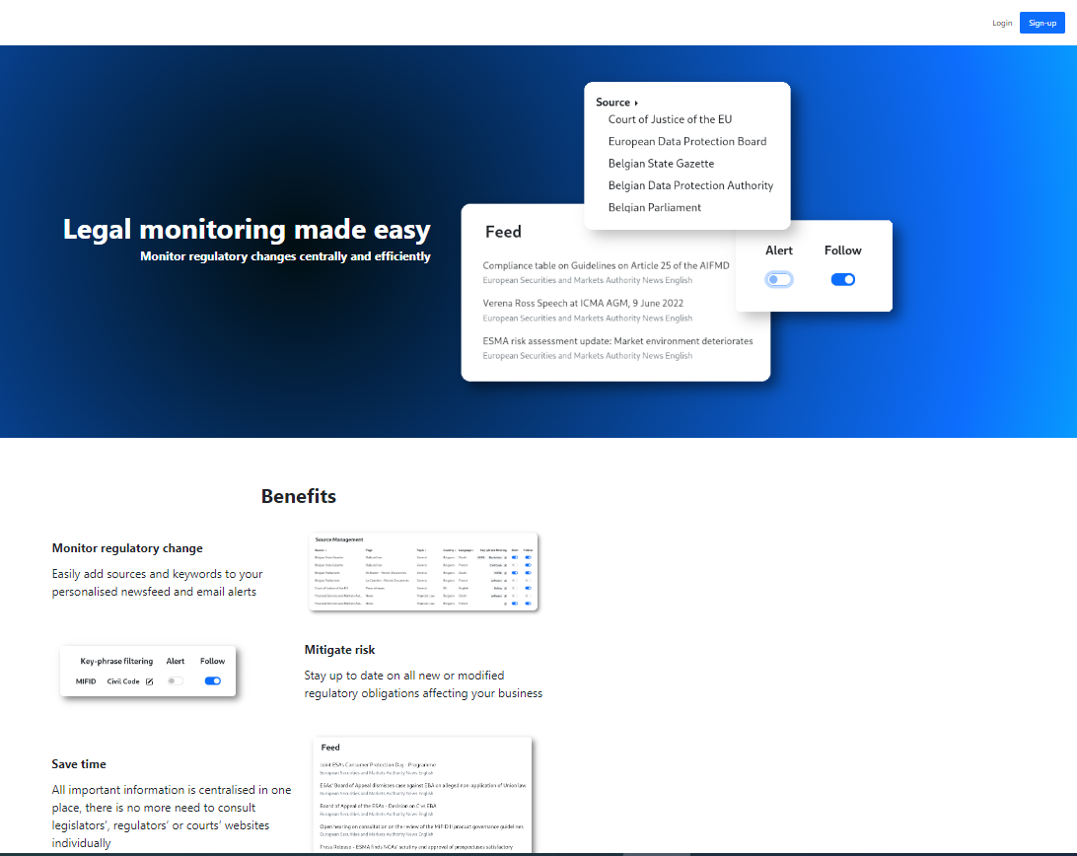
1
2
Notes:
<number>

Slide 3
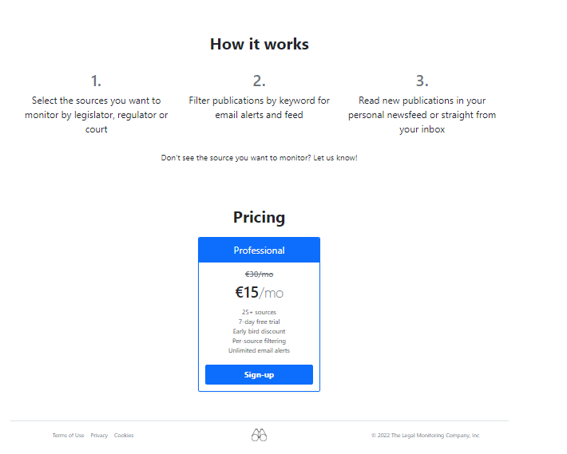
3
4
Notes:
<number>

Slide 4
New homepage

Slide 5

Instructions (1)
The current homepage was developed using simple HTML and CSS (Bootstrap).
We need somebody to redesign and redevelop it to make it look better and more professional, without using a Javascript framework. The output should be HTML, CSS, … files we can integrate in our code.
You are encouraged to use your experience to make it look as good as possible, taking into account the instructions/suggestions in the next slides.
The instructions are based on references to the existing homepage (see first slides) along with new elements.
You will also need the following:
The tool is a LegalTech software. Please take this into account when selecting stock photos (if any)
Screenshots and logo of the application are available here: https://drive.google.com/drive/folders/1-vbDDyKCEfpBmxouLIl4G7AKvFtpdd3S?usp=sharing
Brand colours:
#d9dfdb
#8a7d63
#c7e1f8
#212932 (most used throughout social media communications)
#7b8b99

Slide 6
Instructions (2)
The below are suggestions, if it’s there’s a better way to do it, please suggest:
General:
There should be a flow when scrolling through the page, such as is the case here for example: https://getcarbon.ai/
Pin navigation bar to top and call “sign up” button “Try for free”
Regarding part “1” (see slide 2):
Make it fill the screen when landing on the page
Replace the current colour grading with a stock photo or whatever makes sense in your design. Currently, it’s rather ugly.

Slide 7
Instructions (3)
Insert a block “About Legal-Monitr” between part 1 and part 2:
Title: The regulatory publication monitoring solution for legal professionals
Paragraph: Avoid wasting time visiting tens of webpages per day to stay up to date with new publications of legislators, regulators, supervisory authorities or courts. Legal-Monitr now alerts you of all news relevant to your area of expertise and presents it to you in a comprehensive newsfeed.
Regarding part “2” (Benefits):
Keep current screenshots and copywriting, but make it look nicer.
Make message appear when hovering over the word “sources” in the first paragraph (and make it look like there’s something behind the word, to encourage users to hover over it). The following message should be displayed: “Legal-Monitr currently has a variety of sources for Financial Regulatory and Data Protection professionals in select countries and the European Union as a whole. Sign up for your free trial to consult them all. During the launch phase we are happy to discuss adding sources at users’ request.”

Slide 8
Instructions (4)
Regarding part 3 (How does it work?):
Make “How does it work” look like a timeline and replace current steps with the following:
1: Sign up and create your account
2: Select the sources you want to monitor. Choose from legislators’, regulators’ or courts’ websites
3: Define keywords to further tailor your experience
4: Consult your newsfeed or email alerts to stay up to date
5: Invite team members to join you on the platform
Under the timeline: “Don’t see the source you want to monitor? Let us know!”

Slide 9
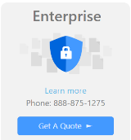
Instructions (5)
Regarding part 4 (pricing)
Make pricing options look more professional
Call the first option “Individual or small teams”
Price: €15/month/user
Keep the rest
Add a second option called “Custom” such as below for example:

